Slide 1
Team Name: Runtime Terror
Team Members:
Haima Krishna
Srushti Shivanand Durgekar
Ananya L.S
Aaryaman Ghosh

Slide 2
Problem Statement
Topic : Trust Lens
The Core Issue : The core issue is that people often trust online content without verification, which can lead to misinformation and scams due to the lack of simple trust-checking tools.
Target Audience: This solution is for students and online users who rely on digital platforms but may not always be able to verify the information.

Slide 3
The Proposed Solution & Innovation
The Solution: Our solution is an AI-based trust detection system that evaluates text and assigns a trust score in real time. It helps users instantly identify whether content is reliable or potentially misleading, reducing the risk of scams and misinformation.
The Differentiator: Unlike traditional methods that depend on user judgment or ratings, our system uses machine learning to provide fast and objective analysis. It is simple, quick, and does not require technical knowledge, making it practical for everyday users.

Slide 4
System Architecture / Workflow
How It Works : The system works in a simple step-by-step process. First, the user enters text such as a review or message through the interface. This input is sent to the backend, where it is processed using a machine learning model. The model analyzes the text, identifies patterns, and calculates a trust score. Finally, the result is sent back to the user, showing whether the content is trustworthy or suspicious.
Interaction: The user interacts with the system through a simple interface by entering text. The frontend sends this input to the backend for processing. The backend performs analysis using the machine learning model and returns the result. The frontend then displays the trust score and classification to the user in real time.
Input
↓
Frontend (UI)
↓
Backend (Python Model)
↓
Text Processing (Vectorizer)
↓
ML Model (Naive Bayes)
↓
Trust Score Output
↓
Display Result to User

Slide 5
Tech Stack & Execution Plan
Programming Language: Python
Machine Learning: scikit-learn (Naive Bayes)
Text Processing: Count Vectorizer
Frontend: HTML / Tkinter (basic UI)
Backend: Python script
Database (optional): SQLite / Firebase
The project starts with collecting sample data and training a machine learning model to classify text . A basic prototype is developed where users can input text and receive a trust score . The system is tested, improved, and can be deployed as a web or mobile application.

Slide 6
Potential Roadblocks
Technical/Logical Challenges : A key challenge is ensuring high accuracy with limited training data. Another challenge is processing diverse and unstructured text, which can reduce prediction reliability.
Edge Cases:The system may struggle with sarcasm, ambiguous language, or very short inputs where context is missing. In such cases, the output may not be fully reliable and should be treated as an assistance tool rather than a final decision-maker

Slide 7
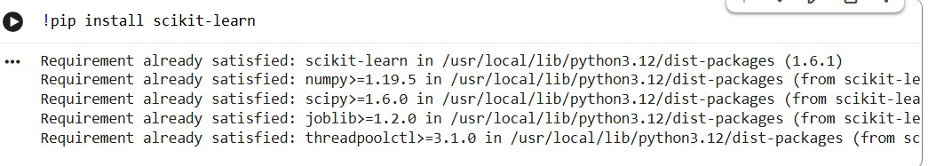
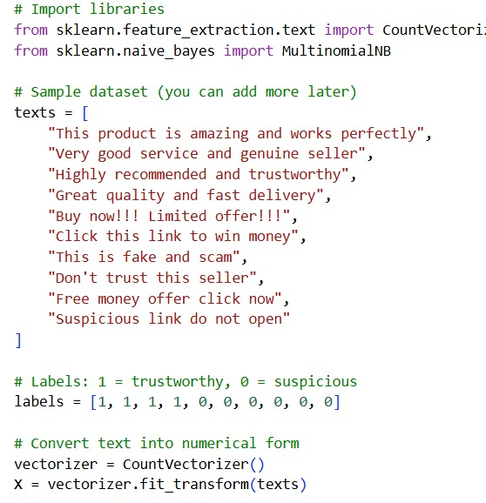
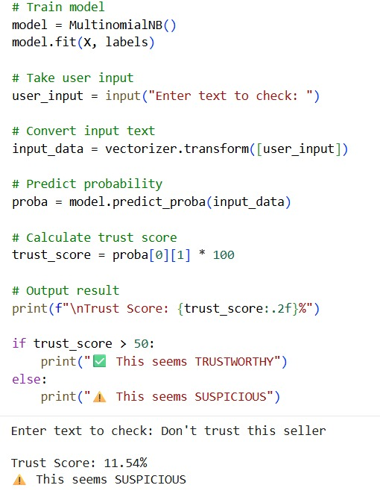

Prototype / Proof of Work (Optional for Bonus Points)

